Slide 1

Presented By
Prof. Dr. Boshir Ahmed
Professor
Dept. of Computer Science & Engineering
Rajshahi University of Engineering & Technology

Slide 2

A router can learn about remote networks in one of two ways:
Manually - Remote networks are manually entered into the route table using static routes.
Dynamically -Remote routes are automatically learned using a dynamic routing protocol.

Slide 3

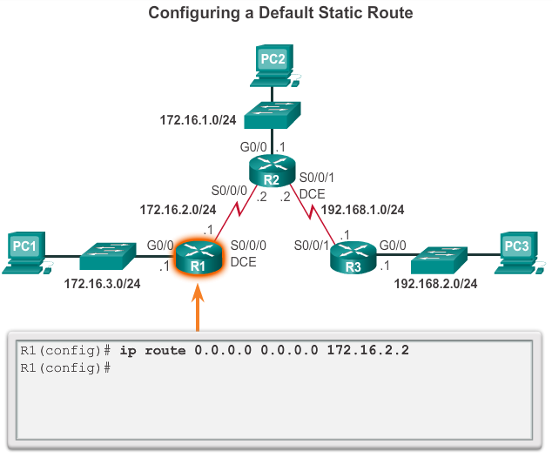
Notes:
Configure a Default Static Route

Slide 4

Static routing provides some advantages over dynamic routing, including:
Static routes are not advertised over the network, resulting in better security.
Static routes use less bandwidth than dynamic routing protocols, no CPU cycles are used to calculate and communicate routes.
The path, a static route uses to send data is known.

Slide 5

Initial configuration and maintenance is time-consuming.
Configuration is error-prone, especially in large networks.
Administrator intervention is required to maintain changing route information.
Does not scale well with growing networks; maintenance becomes cumbersome.
Requires complete knowledge of the whole network for proper implementation.

Slide 6

Static routing has three primary uses:
Providing ease of routing table maintenance in smaller networks that are not expected to grow significantly.
Routing to and from stub networks.
Using a single default route to represent a path to any network that does not have a more specific match with another route in the routing table.

Slide 7

Static Routes are often used to:
Connect to a specific network.
Provide a Gateway of Last Resort for a stub network.
Reduce the number of routes advertised by summarizing several contiguous networks as one static route.
Create a backup route in case a primary route link fails.

Slide 8

Static Routes are four types:
Standard Static Route.
Default Static Route.
Summary Static Route.
Floating Static Route.

Slide 9

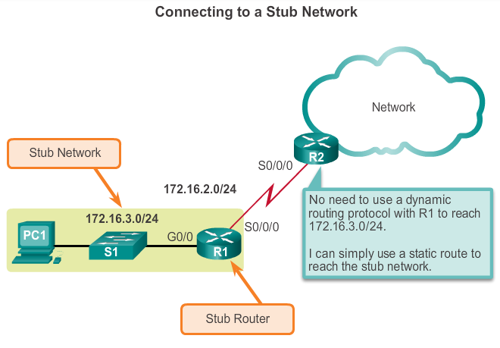

Slide 10

A default static route is a route that matches all packets.
A default route identifies the gateway IP address to which the router sends all IP packets that it does not have a learned or static route.
A default static route is simply a static route with 0.0.0.0/0 as the destination IPv4 address.

Slide 11

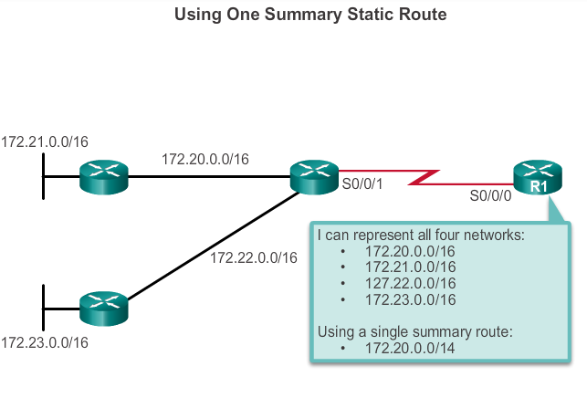

Slide 12

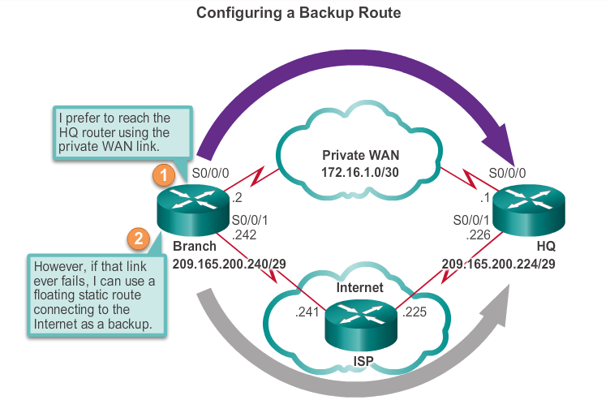
Floating static routes are static routes that are used to provide a backup path to a primary static or dynamic route, in the event of a link failure.
The floating static route is only used when the primary route is not available.
To accomplish
this, the floating static
route is configured with
a higher administrative
distance than the primary
route.

Slide 13

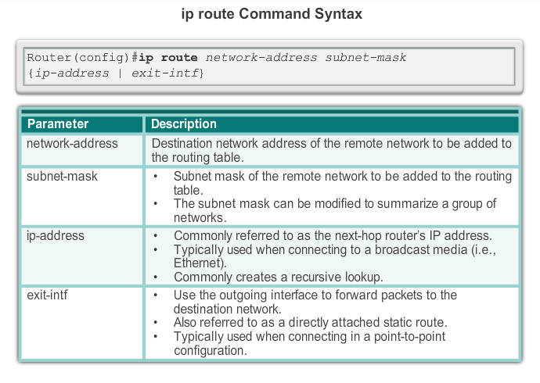

Slide 14

The next hop can be identified by an IP address, exit interface, or both. How the destination is specified creates one of the three following route types:
Next-hop route - Only the next-hop IP address is specified.
Directly connected static route - Only the router exit interface is specified.
Fully specified static route - The next-hop IP address and exit interface are specified.

Slide 15

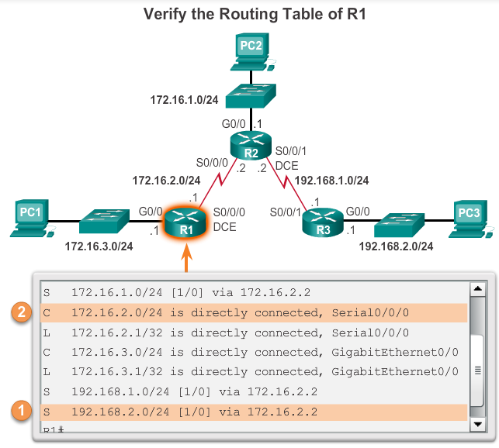
When a packet is destined for the 192.168.2.0/24 network, R1:
1. Looks for a match in the routing table and finds that it has to forward the packets to the next-hop IPv4 address 172.16.2.2.
2. R1 must now determine how
to reach 192.168.2.2; therefore,
it searches a second time for a
192.168.2.2 match.
Notes:
Configure a Next-Hop Static Route

Slide 16

Along with ping and traceroute, useful commands to verify static routes include:
show ip route
show ip route static
show ip route network
Notes:
Verify a Static Route

Slide 17

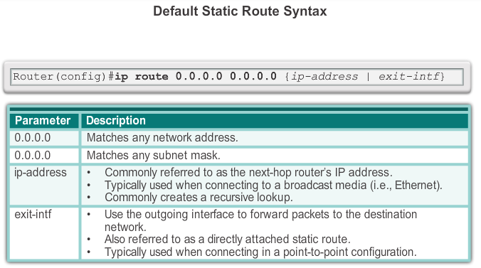
Notes:
Default Static Route

Slide 18

Notes:
Configure a Default Static Route

Slide 19

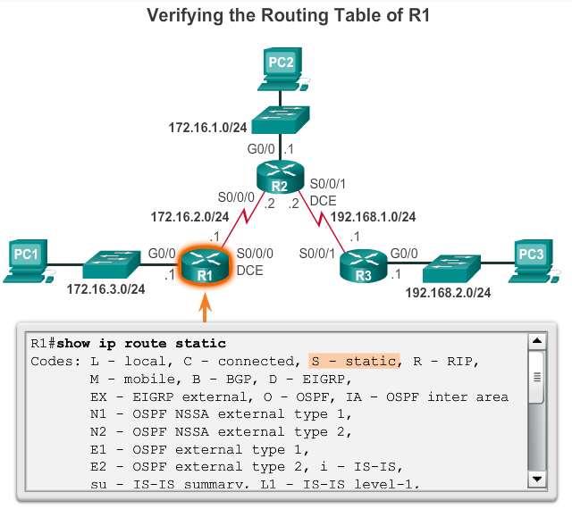
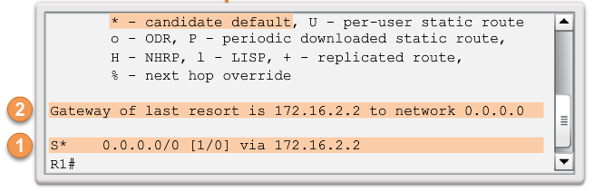
Notes:
Verify a Default Static Route

Slide 20

Floating static routes are static routes that have an administrative distance greater than the administrative distance of another static route or dynamic routes:
The administrative distance of a static route can be increased to make the route less desirable than that of another static route or a route learned through a dynamic routing protocol.
In this way, the static route “floats” and is not used when the route with the better administrative distance is active.
However, if the preferred route is lost, the floating static route can take over, and traffic can be sent through this alternate route.

Slide 21

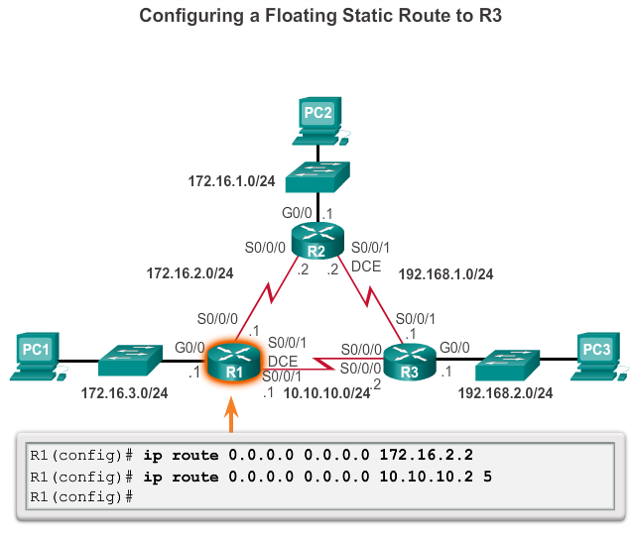
Notes:
6.2.1.6 Verify a Static Route

Slide 22

To test a floating static route:
Use a show ip route command to verify that the routing table is using the default static route.
Use a traceroute command to follow the traffic flow out the primary route.
Disconnect the primary link or shutdown the primary exit interface.
Use a show ip route command to verify that the routing table is using the floating static route.
Use a traceroute command to follow the traffic flow out the backup route.
Notes:
6.2.1.6 Verify a Static Route

Slide 23


Slide 24

Using Standard Static Routing
Consider it as a sample Network
Notes:
6.2.1.6 Verify a Static Route

Slide 25

ip route destination_network_address subnet_mask next_hop_ip_address
  R1(config)#ip route 172.16.1.0 255.255.255.0 172.16.2.2
  R1(config)#ip route 192.168.1.0 255.255.255.0 172.16.2.2
  R1(config)#ip route 192.168.2.0 255.255.255.0 172.16.2.2
  R2(config)#ip route 172.16.3.0 255.255.255.0 172.16.2.1
  R2(config)#ip route 192.168.2.0 255.255.255.0 192.168.1.1
  R3(config)#ip route 172.16.1.0 255.255.255.0 192.168.1.2
  R3(config)#ip route 172.16.2.0 255.255.255.0 192.168.1.2
  R3(config)#ip route 172.16.3.0 255.255.255.0 192.168.1.2
Notes:
6.2.1.6 Verify a Static Route

Slide 26
Using Default Standard Static Routing
Consider it as a sample Network
Notes:
6.2.1.6 Verify a Static Route

Slide 27

Before configure default static route: R1
  Check show ip route now.
    Remember the result.
  Ping 172.16.2.2 from PC1.
    Remember the result.
Configure default static route: R1
  Ip route 0.0.0.0 0.0.0.0 172.16.2.2
  Check show ip route now.
    Is that any difference?
Notes:
6.2.1.6 Verify a Static Route

Slide 28

  Again check Ping 172.16.2.2 from PC1. Anything??
Don’t worry, I’m here ☺
Configure default static route: R2
  Ip route 0.0.0.0 0.0.0.0 172.16.2.1
  Now Ping 172.16.2.2 from PC1. cheers.
  Ping 192.168.1.2 ☺
  I swear last time ping 172.16.1.1
Do the same work on R2 and R3 router.
Notes:
6.2.1.6 Verify a Static Route

Slide 29
Notes:
6.2.1.6 Verify a Static Route

Slide 30
Primary link is as like normal static routing configuration.
Secondary link is same as primary just add an administrative distance!!
Configuration on R1 router:
  ip route 0.0.0.0 0.0.0.0 172.16.2.2
  ip route 0.0.0.0 0.0.0.0 10.10.10.2 5
Notes:
6.2.1.6 Verify a Static Route

Slide 31

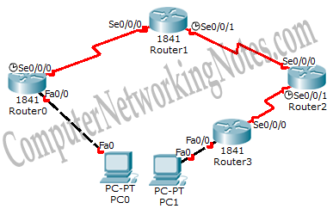
Notes:
6.2.1.6 Verify a Static Route

Slide 32
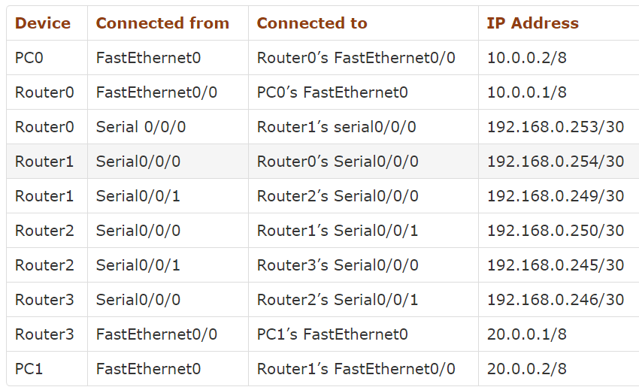
Notes:
6.2.1.6 Verify a Static Route

Slide 33

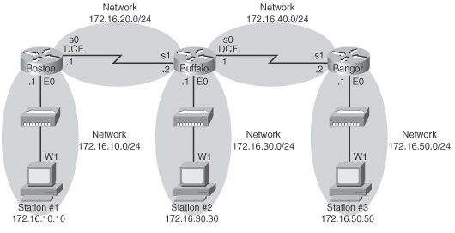
Notes:
6.2.1.6 Verify a Static Route

